Slide 1
Services in Adams County September 29, 2022

Slide 2
Fixed Route
3 Fixed Routes in Gettysburg
All vehicles ADA accessible
$1.00 Per Trip
Registered Seniors 65+ Free
Flag Stops

Slide 3
Paratransit
Provides door-to-door service
Application Process
Advanced Reservation

Slide 4
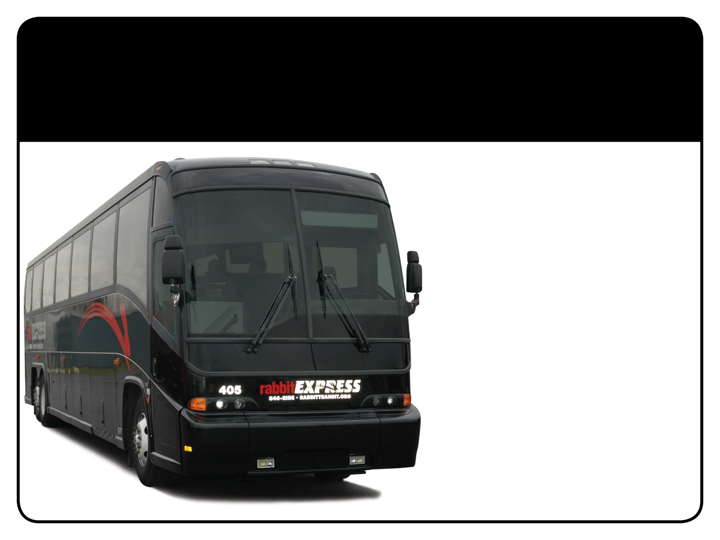
rabbitEXPRESS
Commuter bus service between Gettysburg and Harrisburg
Free WiFi onboard
Emergency Ride Home Program

Slide 5
GHC
Gettysburg-Hanover Connector
Governor’s Workforce Development Pilot
Links the Fixed Route systems of Gettysburg and Hanover
Operates Monday-Friday, 6AM-6PM
All vehicles ADA accessible

Slide 6
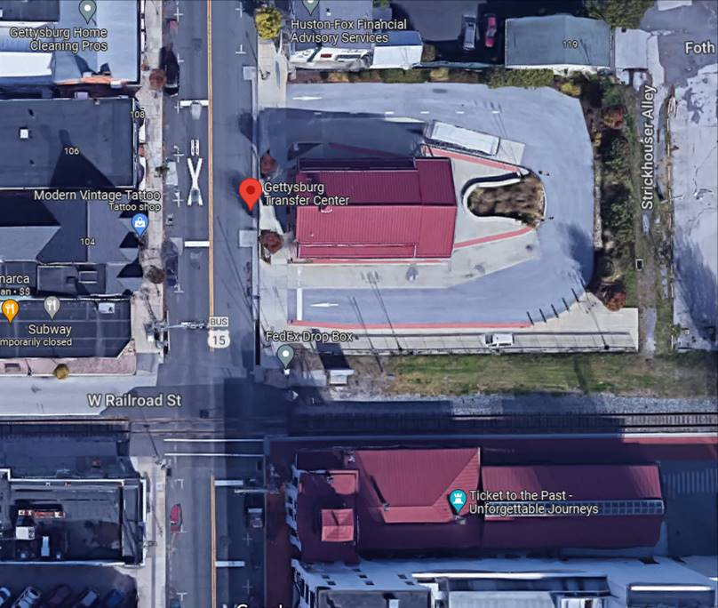
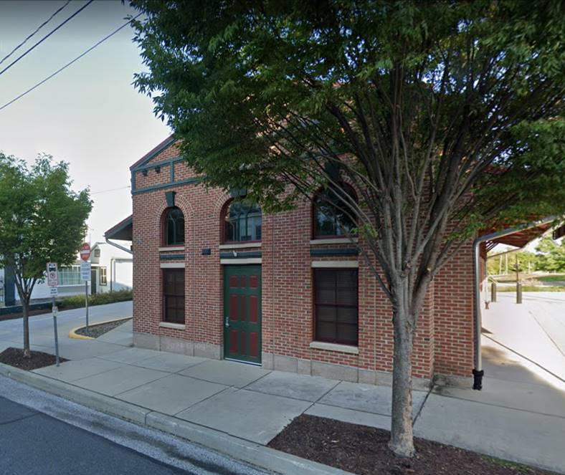
Transit Center

Slide 7
